Slide 1
Marketing Campaign: Southern Tech & Comfort
Enhance sales in the South region with targeted strategies
Ramon Tomzer
8/10/23

Slide 2
Objective
Identify areas of opportunity to increase sales bringing a lagging region in line with other regions.
Enhance sales in the South region by focusing on the top-performing sub-categories: Phones, Machines, and Chairs.
Establish a foothold and expand customer base in given a region

Slide 3
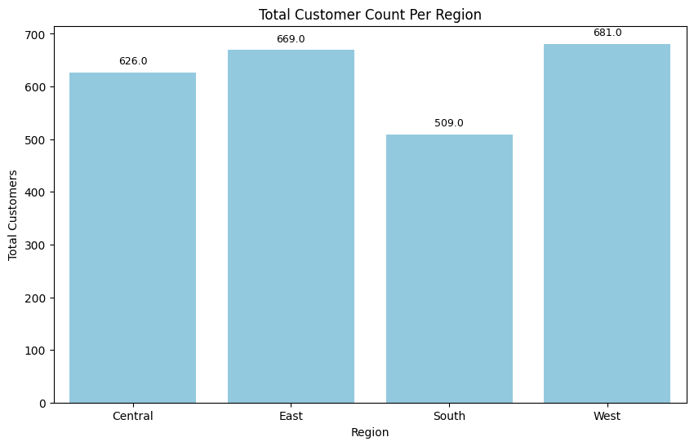
Customers by region

Slide 4
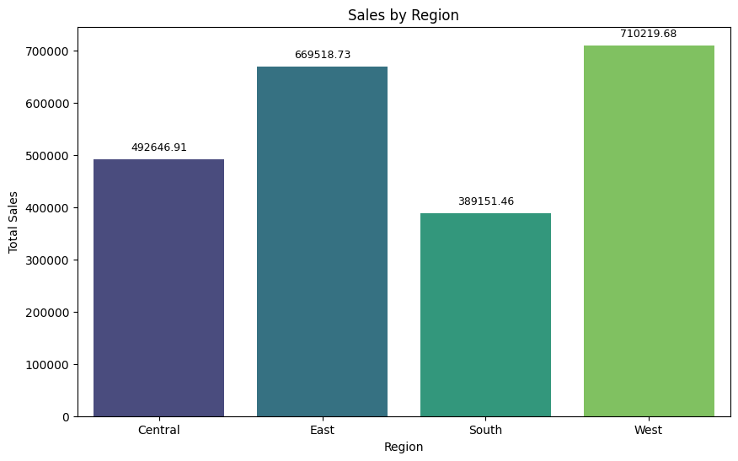
Sales by region

Slide 5
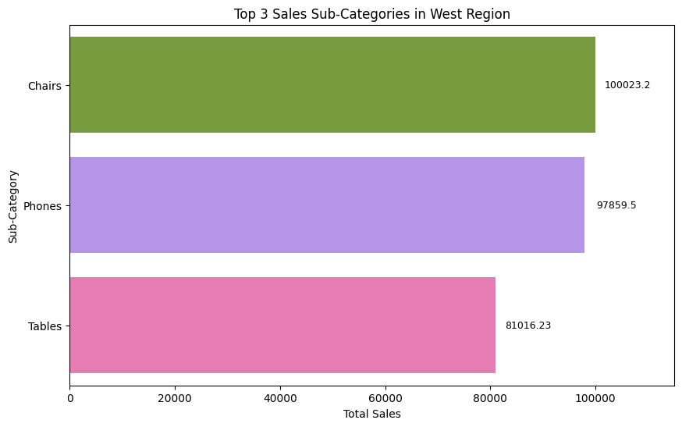
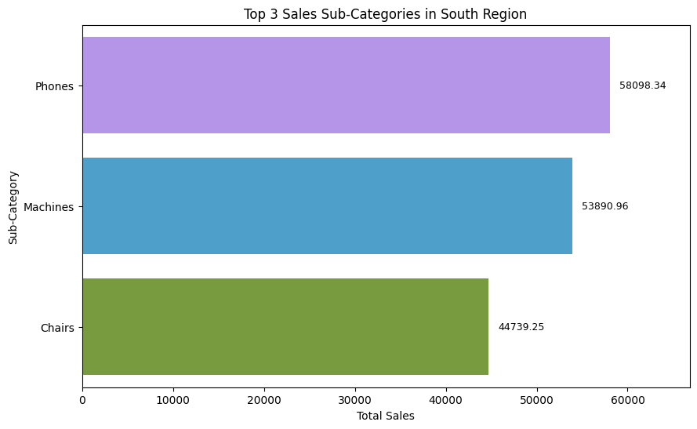
West vs. south regions
Although 2 of 3 sub-categories match in these regions, there is a large disparity of total sales for each subcategory
This is likely due to the much larger number of customers in the west region (approx. 1/3 more customers)

Slide 6
Subcategory sales - south

Slide 7
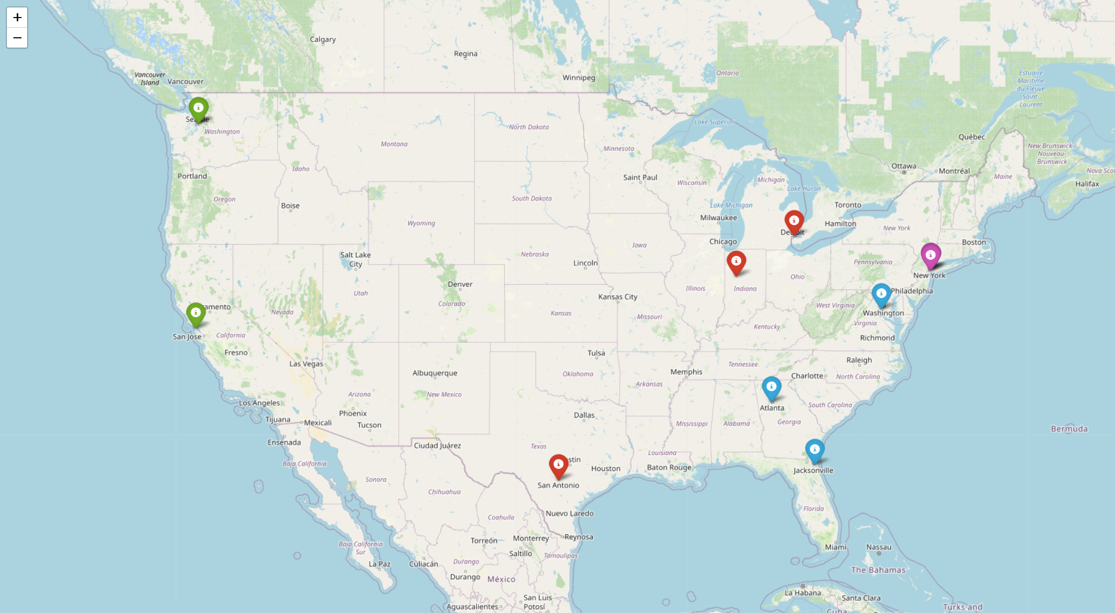
Geographic overlook

Slide 8
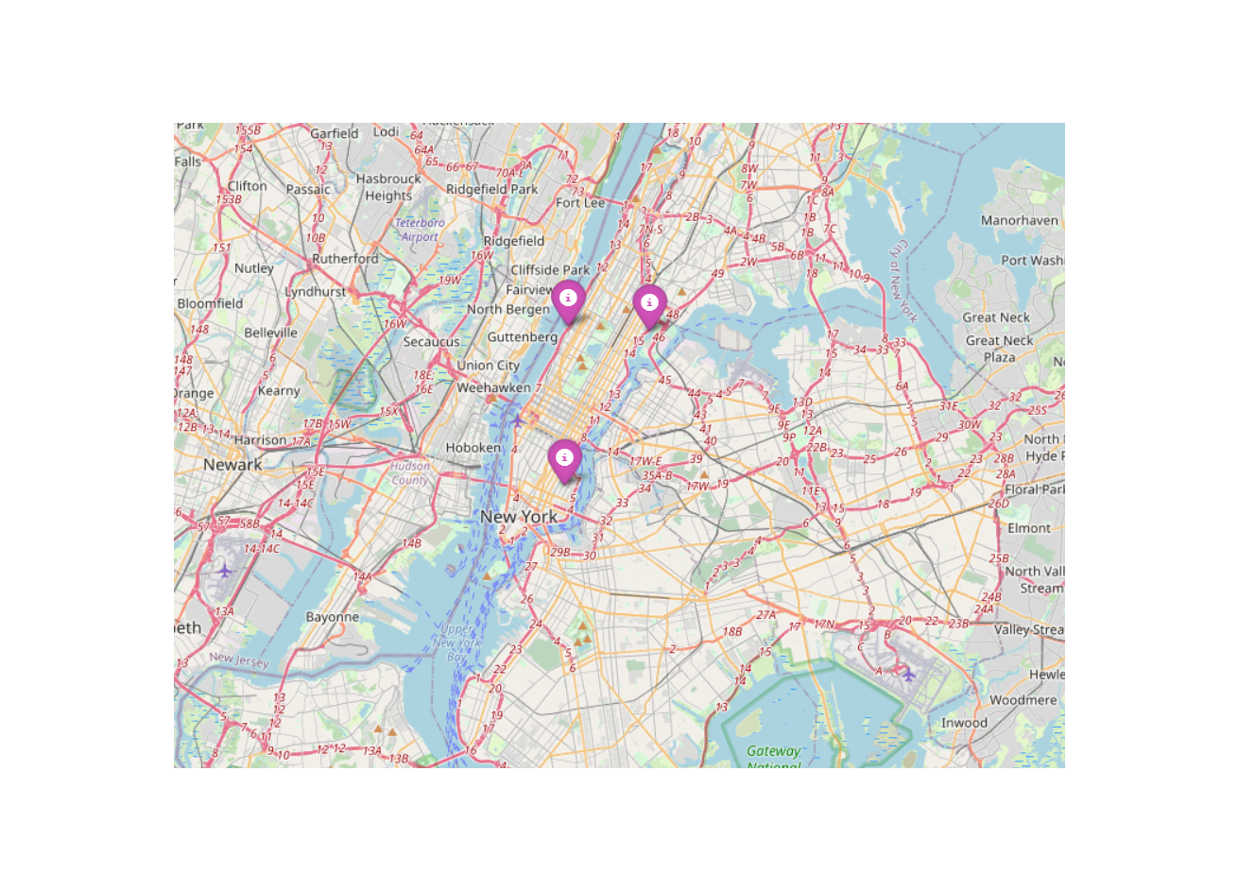
Geographic overlook-East

Slide 9
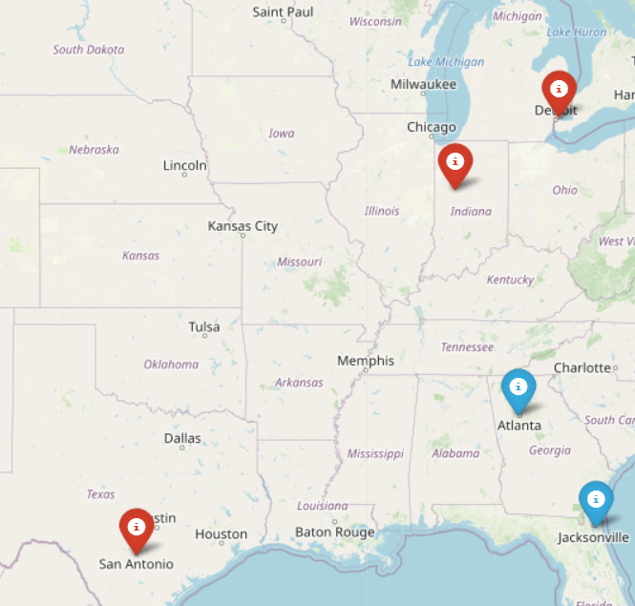
Geographic overlook-central

Slide 10
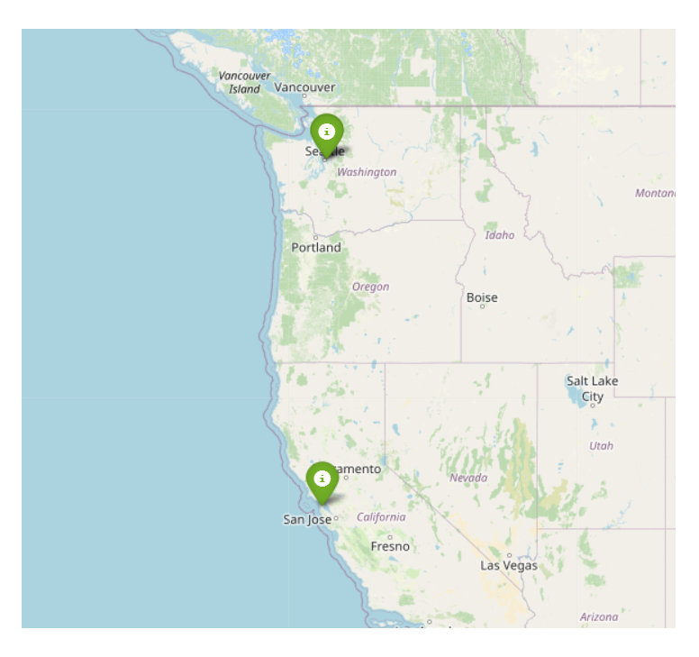
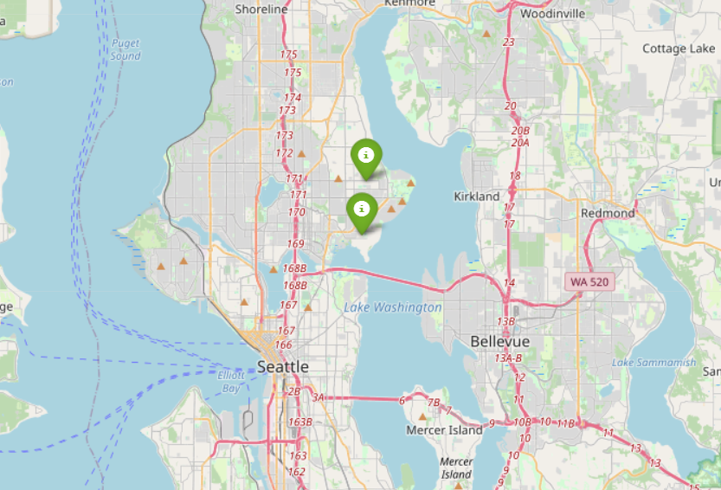
Geographic overlook-west

Slide 11
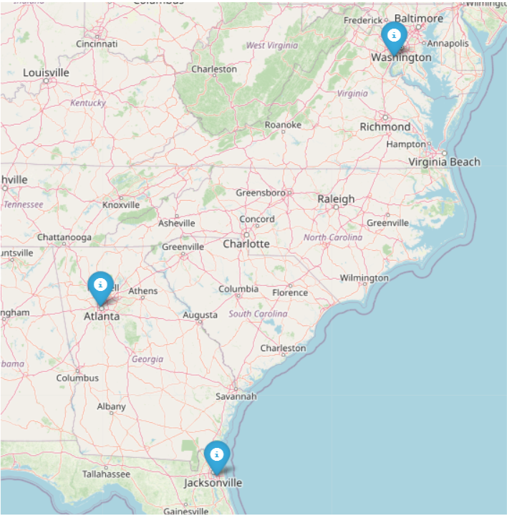
Geographic overlook-South

Slide 12
Tech Connect - South
Sub-Category: Phones
Top Products: Samsung Galaxy Mega 6.3, Samsung Galaxy S4 Active, Wilson SignalBoost
Campaign Strategy:
- Exclusive Discounts: Offer special promotions and bundles on top-selling phones.
- Tech Events: Host virtual tech events showcasing the latest features.
- Partnership with Carriers: Collaborate with local mobile carriers for exclusive deals.

Slide 13
South Office Makeover
Sub-Category: Machines & Chairs
Top Products: Cisco TelePresence System, High-Back Leather Managers Chair, HON 5400 Series Task Chairs
Campaign Strategy:
- Office Upgrade Packages: Create bundled packages combining chairs and video conferencing units.
- Virtual Office Tours: Showcase how these products can enhance the office environment through virtual tours.
- B2B Outreach: Target businesses in the South region for bulk purchases with special discounts.

Slide 14
Cross-Promotion Strategies
- Loyalty Program: Encourage repeat purchases across the top sub-categories by implementing a loyalty rewards program.
- Social Media Engagement: Utilize local influencers to promote products through social media platforms.
- Community Outreach: Participate in community events and fairs to create brand awareness.

Slide 15
Measurement & Evaluation
- Sales Tracking: Monitor sales of targeted products to assess campaign effectiveness.
- Customer Feedback: Gather feedback through surveys to understand customer preferences.
- ROI Analysis: Evaluate the return on investment to ensure that the campaign is cost-effective.

Slide 16
Conclusion
This campaign leverages the data-driven insights from the South region to create targeted promotions and activities that resonate with local preferences and needs. By focusing on top-performing products within key sub-categories, the campaign aims to optimize sales and customer engagement.

